Slide 1
ServiceNow Internal Training
For SuperUser

Slide 2
Agenda
Overview
Queue
Request for new Catalog Item
Roles
How to access ServiceNow via Self Service and Portal
Chat Feature
Change
Incidents
Project
Dashboard

Slide 3
Overview
ServiceNow is scheduled to replace the current ESMT process. ServiceNow will be the new ticketing system.
ECG has created an internal portal which will house all ECG processes documents (Link ECG SharePoint portal for list)

Slide 4
Queue
Currently we have 55 queues in our organization. The ECG portal there is a document that shows all the names, owners, and services being offered. (Link ECG SharePoint portal for list)

Slide 5
Request for New Service Catalog items
When requesting for a new catalog item, the user will download and fill in the catalog item template. The catalog template is located on the ECG ServiceNow portal called “Catalog Item Template” (Link to portal document). After you have completed the template, please send via email to the GOS team for processes. The GOS team will reach out you to and your team to review your template and provide you a demo of the item before implementing.

Slide 6
Roles
The following are the ESMT and Service Now roles available and definition
ESMT Role | Service Now Role
Change Manager (CRM) | ITIL
Incident Manager (IN) | ITIL
Service Request Manager (SRM) | ITIL
Configuration Manager (CFM) | Configuration Items (CI) most of our CI’s will be created via discovery tool. Currently ITSM will creating the new CI item that are not discoverable.
New ServiceNow Roles | Definition (need to obtain the definition from my documentation)
ITIL

Slide 7
How to access ServiceNow Self Service and Portal
Service now can be access via ServiceNow catalog or the ServiceNow portal
Insert image of catalog view
Insert image of portal

Slide 8
Chat Feature
Connect Chat is a real-time messaging tool that enables users to chat with individuals and groups, quickly share files, and collaborate on any record by connecting with the right people instantly.
Features include: Direct conversations between two users.
Group conversations between three or more users.
Conversations linked to records. Comments and work notes appear in conversations in real time and users can update the record directly from the conversation.
Drag-and-drop sharing of links, files, and records.

Slide 9
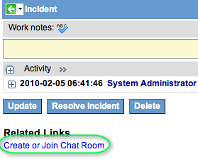
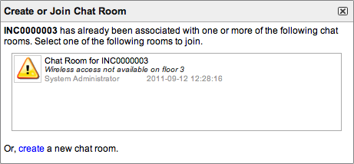
Chat Feature
Click the create link at the bottom of the window.
Enter the room details as you would for a chat room.
Click Create Room. An email notification is sent and appears in the favorites list for all invited users (the assignment group and the watch list, if selected, and additional invited users).
In the New Room Created message, click Join Room.A new chat window opens on your chat desktop.
All invited users are listed in the chat member list. Invited users that are not currently participating in the chat are listed in gray.

Slide 10
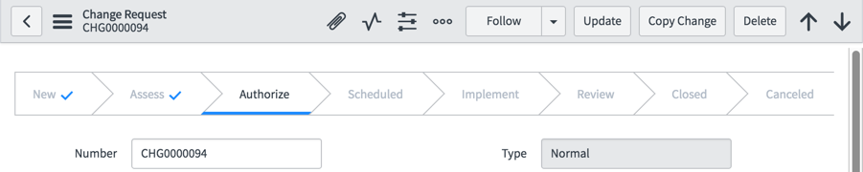
Change Workflow
Changes offers a state model to move and track change requests through several states.
Example of state transitions for a normal change request

Slide 11
Change Status
Status | Description
New | Change request is not yet submitted for review and authorization. A change requester can save a change request as many times as necessary while building out the details of the change prior to submission.
Assess | Peer review and technical approval of the change details are preformed during this state
Authorization | Change Management and the CAB schedule the change and provide final authorization to proceed,
Scheduled | The change is fully scheduled and authorized and is waiting for the planned start date. An email notification is sent to the user who request the change.
Implementation | The planned start date has approached and the actual work to implement the change is being conducted. An email notification is sent to the user, who requested the change.
Review | The work has been completed. The change requester determined whether the change was successful. A post-implementation review can be conducted during this state. An email notification is sent to the user who requested the change.
Closed | All review work is complete. The change is closed with no further action required.
Canceled | A change can be canceled at any point when it is no longer required. However, a change cannot be canceled from a closed state. An email notification is sent to the user who requested the change.

Slide 12
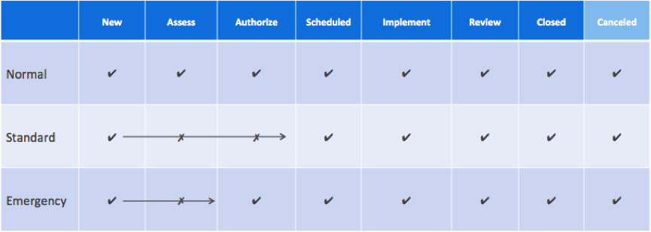
Change Type Status

Slide 13
How to create a Change Request
Insert picture on how to create an Change from
CI
Catalog
Portal

Slide 14
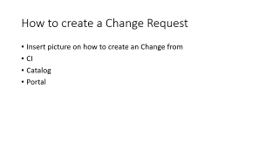
Change Request Templates
A change request has the ability to apply templates that has been created from the ESMT job plan.
Link to ECG templates table

Slide 15
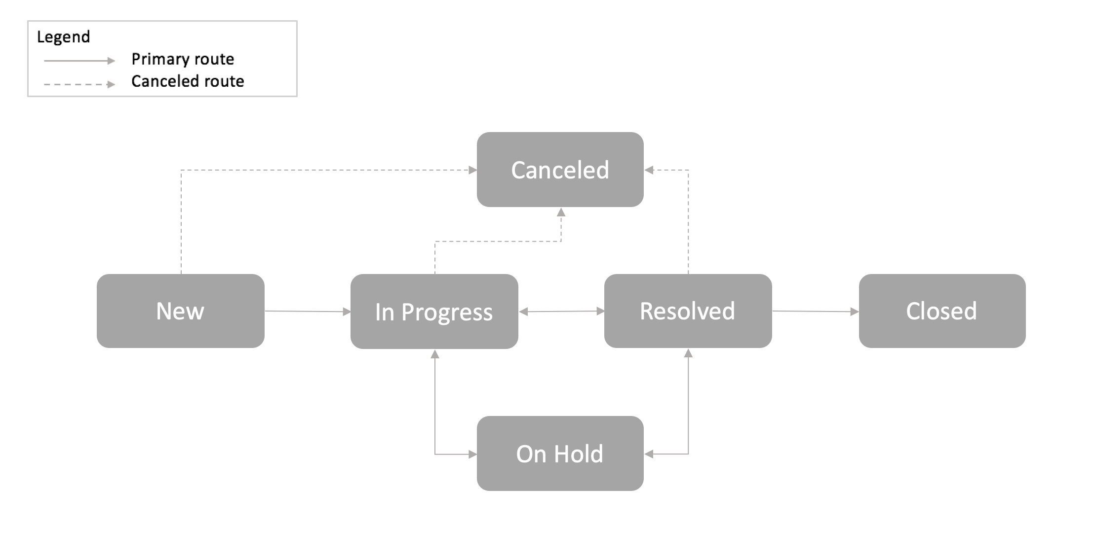
Incident Workflow
Incident will follow this workflow

Slide 16
Incident Status Definitions
Status | Description
New | Incident is logged but not yet triaged.
In progress | Incident is assigned and is being investigated.
On Hold | The responsibility for the incident shifts temporarily to another entity to provide further information, evidence, or a resolution. When you select the On Hold option, the On hold reason choice list appears. If the On Hold reason is Awaiting Caller, the Additional comments becomes mandatory. Note: If the caller updates the incident, the On hold reason field is cleared and the state of the incident is changed to In Progress. An email notification is sent to the user in the Assigned to field as well as to the users in the Watch list. An incident can be placed in the On hold state one or more times prior to being closed.
Resolved | A satisfactory fix is provided for the incident to ensure that it does not occur again.
Closed | Incident is marked Closed after it is in the Resolved state for a specific duration and it is confirmed that the incident is satisfactorily resolved.
Canceled | Incident was triaged but found to be a duplicate incident, and unnecessary incident, or not an incident at all.

Slide 17
How to create an Incident
Insert picture on how to create a Change from
CI
Catalog
Portal

Slide 18
Incidents Templates
Link to ECG templates table

Slide 19
Project Workflow
Projects will follow this workflow

Slide 20
Project Request Fields
Request and track the changes related to the resource, scope, cost, and schedule for your project.
Field | Description
Number | System-Generated
Category | Category for the request
Priority | Priority for the change
State | Current state of the change
Impact | Impact level
Estimate Cost | Estimate cost to carry out the change
Due Date | Planned date to complete the change
Approval | Approval status for the change
Title | Title for the change request
Description | Detailed description of the change request
Business Justification | Reason why the proposed change in project is required
Additional Comments | Comments to indicate progress on the change request

Slide 21
Project Templates
A project template defines the basic structure of a project.
Project templates can include project tasks and subtasks, attachments, checklists, and other project information. Because projects often get repeated, templates enable you to create, save, and reuse project structure. You can also modify existing templates, create projects from templates, and apply templates to empty projects. A project is considered empty when it does not contain any subtasks.

Slide 22
How to create a Project
Insert picture on how to create a Change from
CI
Catalog
Portal

Slide 23
Knowledge Articles
Create a knowledge article from an:
Incident
Change request
Problem
Task
Need to insert workflow

Slide 24
Dashboard
Insert picture of dashboard

Slide 25
Add a report to a dashboard or homepage
Make actionable decisions faster by combining relevant reports and widgets onto a dashboard or a homepage. Navigating to single reports and widgets is time-consuming and less efficient.
Before you begin
Role required: Any user who can create a report can add it to a responsive dashboard or a homepage.
To add a report to a non-responsive dashboard, one of the following roles is required: itil, report_user, report_global, report_group, report_admin, pa_power_user.Note: It is recommended to add a report to a dashboard. Homepages have more restrictive layouts and permission structures than dashboards. For more information, see Differences between homepages and responsive and non-responsive dashboards.
Procedure
Click the Settings icon.
Select the General tab.
Under Home, select Dashboards or Homepages.

